Slide 1

Distributed Computing
Ch.1
Distributed Computing
Presented By:-
RIDDHI JOSHI,
Assistant Professor,
Marwadi University

Slide 2
Roadmap part-1
→ 1.1 Introduction & Definition
1.2 History of DC
1.3 Different forms of Computing
1.4 Strength & Weakness
1.5 Basics of OS
1.6 Network Basics
1.7 Software Engineering Basics
1.8 The Architecture of Distributed Application.
1.9 Distributed Computing Paradigms – Paradigms & Abstraction
1.10 An Example Application,
1.11 Paradigms for Distributed Applications

Slide 3
1.1 What is Distributed Computing?
Early computing was performed on a single processor. Uni-processor computing can be called centralized computing
Definition by book:
- A distributed system is a collection of independent computers, interconnected via a network, that are capable of collaborating on a task.
- A distributed computing is a computing performed on a distributed system.

Slide 4
What is Distributed Computing?
Distributed computing refers to a model in which multiple interconnected computers work together to solve a single problem or perform a task. These computers, often referred to as nodes or machines, share resources and communicate with each other to achieve a common goal.
Distributed computing aims to achieve greater efficiency, reliability, and scalability by leveraging the combined processing power, storage, and communication capabilities of multiple machines.
DEFINITION : DC is a model where multiple independent computers or servers communicate over a network to achieve a common goal.

Slide 5
What is Distributed systems ?

Slide 6
Distributed Computing
Key Characteristics:
Concurrency: Tasks can be executed concurrently on different machines.
Scalability: The system can be scaled horizontally by adding more machines.
Fault Tolerance: The system can continue to operate even if some machines fail.
Resource Sharing: Nodes share resources such as CPU, memory, and storage.
Transparency: The complexity of the distributed nature is hidden from the user.

Slide 7
Distributed Computing
Example: MapReduce Framework
MapReduce is a widely-used distributed computing framework designed to process large data sets across a distributed cluster of computers.
It was originally developed by Google and is now implemented in various big data processing platforms like Apache Hadoop.
How MapReduce Works:
Map Phase:
The input data is divided into smaller chunks.
Each chunk is processed in parallel by a different node in the cluster.
The processing involves applying a map function that transforms the input data into key-value pairs.
Shuffle and Sort Phase:
The key-value pairs produced by the map function are grouped by key.
The data is shuffled and sorted to prepare for the reduce phase.
Reduce Phase:
The grouped key-value pairs are processed by the reduce function.
The reduce function aggregates or summarizes the data based on the keys.
The final output is a set of key-value pairs representing the aggregated data.

Slide 8
What is Distributed systems ?
Hardware is distributed
n processing elements (processor + memory)
Interconnected by some network
No shared memory
Software is distributed
No centralized OS, each system has its own copy of OS
No physically centralized file system
Means for inter-process communication is message passing at the lowest level

Slide 9
Why Distributed systems ?
Information exchange (collaborative work)
Resource sharing (e.g. printer, backup storage, disk units, etc.)
Resource sharing (applications, information, media, services)
Cost reduction
Increase of availability (partial failure)
Increase of performance through parallelism

Slide 10
Few Other Definitions
Distributed computing is when you take a large task and break it down into many small parts and have an entire bank of computers working on the project instead of just one.
This allows for a project to be completed faster, using the processing power of many computers which are in the bank that is working on the project.

Slide 11
Cont…
Simply put, distributed computing is a way to take a task that would take one computer million years to complete, and instead hand it to a million computers, thus making the task obtainable.
By Wikipedia: Distributed computing also refers to the use of distributed systems to solve computational problems. In distributed computing, a problem is divided into many tasks, each of which is solved by one or more computers

Slide 12
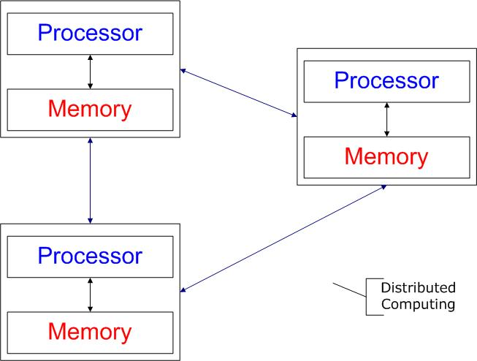
Fig. Shows Distributed Computing

Slide 13
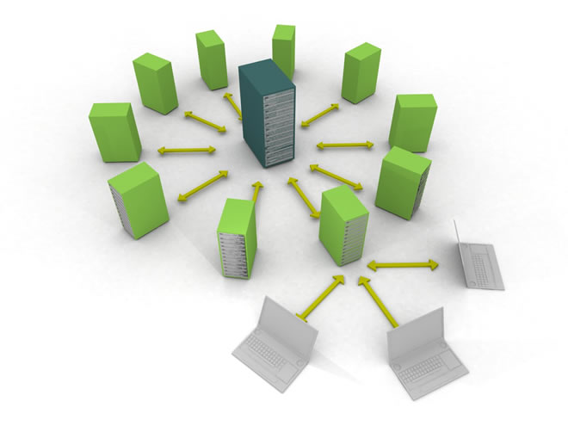

Slide 14
Comp. in Distributed Computing
Workstations:
computers used by end-users to perform computing (desktops or laptops)
Server machines:
computers which provide resources and services
Personal Assistance Devices:
Handheld computers connected to the system via a wireless communication link. Like tab PCs

Slide 15
DC mainly for…
Network Services: A network service is a special kind of program known as a server on a network. The WWW is such a service, as is email and FTP.
Network Applications: A network application is an application that runs on networked computers for end users. Network application like online shopping carts, electronic auctions and noncommercial like chat rooms and network games.

Slide 16
Ex. of Distributed Computing
Network of workstations (NOW):
A group of networked personal workstations connected to one or more server machines.
An intranet:
A network of computers and workstations within
an organization, segregated (divide) from the Internet
via a protective device (a firewall).
An Internet
ATM (bank) machines
Airline reservation system

Slide 17
Internet Vs. Intranet
Internet is network of Computers which is open for all.
Internet itself contains a large number of intranets.
Unlimited number of users.
Visitors traffic is unlimited.
Contains unlimited source of information.
Intranet is network of Computers designed for a specific group of users.
Intranet can be accessed from Internet but with restrictions.
Limited number of Users.
Limited visitors traffic.
Contains only specific group purpose information.

Slide 18
Roadmap
1.1 Definition
→ 1.2 History of DC
1.3 Different forms of Computing
1.4 Strength & Weakness
1.5 Basics of OS
1.6 Network Basics
1.7 Software Engineering Basics
1.8 The Architecture of Distributed Application.

Slide 19
1.2 History of Distributed Computing
The beginning of Computing
Standalone Computers
Each is used to execute stored programs
Each of which are connected to exchange data
First connection of Two computers….
In 1960s
Manual connection and exchange data
Autonomously run application
Can’t share load of executing applications.
Which lead to discover distributed computing.

Slide 20
Cont…
First Request for Comments (RFC)
RFC 1 is a proposal which specifies how participating hosts can exchange information with each other through messages.
Earlier network services…
First network services was email which is reportedly sent in 1972 on a four node (comp. or host) of ARPANET.
Automated file transfer mechanism which allowed data files to be exchanged between hosts. Was requested in 1971..
A Node:
A node on a network is a computer or host that participates in the network.

Slide 21
Cont…
Email and File Transfer is the most popular network services.
The best known network service is World Wide Web (WWW).
WWW has since become a platform for network application and services , including emails, search engines.
Until 1990 ARPANET the initial in internet was used by scientist, researchers and academicians.

Slide 22
Roadmap
1.1 Definition
1.2 History of DC
→ 1.3 Different forms of Computing
1.4 Strength & Weakness
1.5 Basics of OS
1.6 Network Basics
1.7 Software Engineering Basics
1.8 The Architecture of Distributed Application.

Slide 23
1.3 Different Form of Computing
As we are learning DC we should know various form of computing.
Monolithic Computing
Distributed Computing
Parallel Computing
Cooperative Computing

Slide 24
1. Monolithic Computing
In this simplest form of computing a single computer, such as personal computer is used for computing.
The computer is not connected to any network and thus it may be use only those resources within its immediate access. This form of computing called as MONOLITHIC COMPUTING.
Multiple users can engage in monolithic computing. This form of computing, where the resources of a single computer can be shared by concurrent users using a technique known as timesharing.
The computer that provides the centralized resource is called a mainframe.

Slide 25
1. Monolithic Computing
There are two types: single user monolithic computing and multi-user monolithic computing.
Single user monolithic computing In this type of computing, the computer is used by only one user at a time.
The computer can use resources only within its immediate access.
Applications such as spreadsheet or word processing program practise this form of computing.
Multi-user monolithic computing
In this type of computing, multiple users can share the resources using a technique called timesharing.
Usually mainframe is used to proved the centralized resource. Users can access mainframe system through terminals.
Applications such as payroll and billing practise this form of computing.

Slide 26
2. Distributed Computing
Distributed Computing involves computing performed among multiple network-connected computers.
Each of which has its own processors and other resources
A user, using a workstation, has full use of the resources on the local computer to which its workstation is connected
In addition through the interaction of the local computers and the remote computers, the user may access resources on the remote computers.

Slide 28
3. Parallel Computing
Parallel Computing uses more than one processors simultaneously to execute a single program “Ideally, parallel processing makes a program run faster because there are more engines (CPUs) running it.
Today Parallel computing largely used in scientific computing in areas such as biology, aerospace, weather forecasting, and semiconductor design.

Slide 29
3. Parallel Computing
Advantages of Parallel Computing over Serial Computing are as follows:
It saves time and money as many resources working together will reduce the time and cut potential costs.
It can be impractical to solve larger problems on Serial Computing.
It can take advantage of non-local resources when the local resources are finite.
Serial Computing ‘wastes’ the potential computing power, thus Parallel Computing makes better work of the hardware.

Slide 30
4. Cooperative Computing
Recently the term Distributed Computing has also been applied to cooperative computing projects such as the Search for Extraterrestrial Intelligence (SETI).
These are projects that parcel out large scale computing to workstations on Internet hosts making use of surplus CPU cycles.

Slide 31
Roadmap
1.1 Definition
1.2 History of DC
1.3 Different forms of Computing
→ 1.4 Strength & Weakness
1.5 Basics of OS
1.6 Network Basics
1.7 Software Engineering Basics
1.8 The Architecture of Distributed Application.

Slide 32
1.4 Strength & Weakness of DC
Before 1980s the Computers were used for word processing and spreadsheet management. It is the maximum use of COMPUTERS.
Thomas Watson The Founder of IBM was said to have the statement in 1943 “I think there is a world market for may be five computers”
After 1980s, however distributed computing has become as important as – if not more important than- monolithic computing.

Slide 33
Strength
Advantages of the Distributed Computing System are:
Scalability: Distributed systems are generally more scalable than centralized systems, as they can easily add new devices or systems to the network to increase processing and storage capacity.
Reliability: Distributed systems are often more reliable than centralized systems, as they can continue to operate even if one device or system fails.
Flexibility: Distributed systems are generally more flexible than centralized systems, as they can be configured and reconfigured more easily to meet changing computing needs
. Fault Tolerance:
Distributed computing provides the opportunity of fault tolerance in that resource can be replicated to sustain its availability in the presence of failure. For ex. Backup copy in network.

Slide 34
Weaknesses
There are a few limitations to Distributed Computing System
Complexity: Distributed systems can be more complex than centralized systems, as they involve multiple devices or systems that need to be coordinated and managed.
Security: It can be more challenging to secure a distributed system, as security measures must be implemented on each device or system to ensure the security of the entire system.
Performance: Distributed systems may not offer the same level of performance as centralized systems, as processing and data storage is distributed across multiple devices or systems.

Slide 35
Roadmap
1.1 Definition
1.2 History of DC
1.3 Different forms of Computing
1.4 Strength & Weakness
→ 1.5 Basics of OS
1.6 Network Basics
1.7 Software Engineering Basics
1.8 The Architecture of Distributed Application.

Slide 36
Operating System
Distributed computing involves programs running on multiple computers.
We should know some concepts involved with the execution of programs in modern day computers.
“ An Operating system is a set of programs that control the execution of application program and acts as an interface between application and computer hardware.”

Slide 37
Computer Program & Processes
What is computer program?
A software program is artifact(well designed) constructed by a software developer.
Using some form of programming languages.
Typically the language is high level one that requires a compiler or an interpreter to translate it into machine language when a program is run or executed.

Slide 38
Basics of OS
Uniprogramming : One Processor executing one process.
Multiprogramming : One Processor executing multiple processes.
Multiprocessing : Multiple processors executing multiple processes.
Concurrency: It is a property of systems in which several computations are executing simultaneously, and potentially interacting with each other.
It means managing the interaction of all of the processes.
Thread : - Part of the process

Slide 39
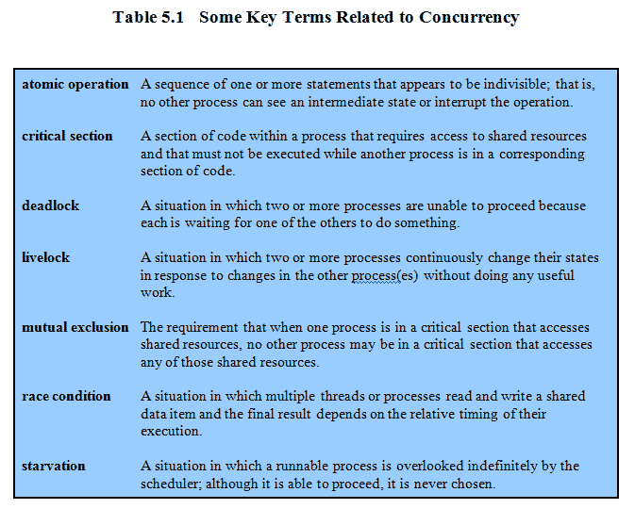
KEY TERMS

Slide 40
SR. NO: | PROCESSES | THREADS
1 | Process is unit of allocation i.e. Resources, privileges, etc. | Threads are unit of execution which includes pc,sp and register
2 | Each process has one or more threads | Each thread belongs to one process.
3 | Inter process communication is expensive i.e Context switching required | Inter thread communication is cheap. Don't required process switching.
4 | These are secure because one process can not corrupt another process | These are not secure because a thread can write memory used by another thread.
5 | Take more time to create a process. | Takes less time to create a thread.
6 | Take more time to terminate a process | Takes less time to terminate a thread
7 | Take more time to switch between processes | Take less time to switch between threads
8 | It has more communication overheads | It has less communication overheads
9 | Processes are independent of one another. | Threads are not independent of one another.

Slide 41
What is Process?
Above task is represented as process.
On modern computers a process consists of an
Executing program
Its current values
State Information
Resource used by OS to manage the program execution
In other words “Process is a dynamic entity that exist only when a program is run”

Slide 42
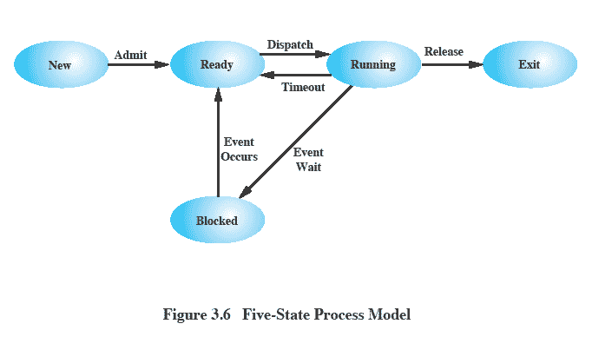
Five State process model

Slide 43
Example: Java processes
There are three types of Java program: applications, applets, and servlets, all are written as a class
A Java application program is run as an independent(standalone) process
An applet is run using a browser or the applet viewer
A servlet is run in the context of a web server
A Java program is compiled into byte code, a universal object code. When run, the byte code is interpreted by the Java Virtual Machine (JVM). A just-in-time compiler (JIT) improves execution speed.

Slide 44
Three types of Java programs
Applications
A program whose byte code can be run on any system which has a Java Virtual Machine. An application may be standalone (monolithic) or distributed (if it interacts with another process).
Applets
A program whose byte code is downloaded from a remote machine and is run in the browser’s Java Virtual Machine.
Servlets
A program whose byte code resides on a remote machine and is run at the request of an HTTP client (a browser).

Slide 45
A stand alone java application is run on a local machine
Computer
Java Object
Java Virtual Machine

Slide 46
An Applet is an object downloaded from remote machine and then run on a local machine….
Computer
Java Object
An Applet
Java Virtual Machine

Slide 47
A servlet is an object that runs on a remote machine and interact with a local process using a request-response protocol
A Servlet
Request
A process
Response

Slide 48
Concurrent Programming
Distributed computing involves concurrent programming.
Which is programming that involves the simultaneous execution of process. We look at three kinds of concurrent programming.
Concurrent processes executed on multiple computers
Concurrent processes executed on a single computer.
Concurrent programming in a process.

Slide 49
Concurrent Process Executed on multiple computers:
Till this time we learn separate process running concurrently on separate, independent computers interconnected via a network.
The process interact with each other by exchanging data over the network, but their execution is otherwise completely independent.
Concurrent programming involving multiple machines requires programming support; that is,
the software for the participating program must be written to contain logic to support the interaction between processes.

Slide 50
Concurrent process executed on a single computers
Modern computers are supported with multitasking OS.
The concurrency may be real or virtual.
True concurrency multitasking on a single computer is feasible only if the computer has multiple CPUs.
So that each CPU can execute a separate process.
Computers with single CPU uses Time Sharing or Time Slicing method for execution.
Processes
P1
P2
P3
P4
time
Timesharing of a resource

Slide 51
Concurrent programming in a process:
Not only process but program also need to initiate tasks that are to executed concurrently.
Sometimes it is compulsory to perform another task while waiting for first task to complete.
It may also be desirable for a program to execute tasks in parallel, for performance reason.
Concurrent programming within a process is performed by two ways.
- Parent and Child Process
- Thread.

Slide 52
Parent and child process
At run time a process may release subordinate process or child processes through real or virtual multitasking.
The original process called the parent process, continues to run simultaneously with the child process.
A child process is a complete process, consisting of an executing program, its own current values, and state information, some of which inherited from the parent process.
A process can be notified when a child process has terminated.

Slide 53
Concurrent processing within a prcess.
A process may release child threads
A process may release child process
A Process
Parent Process
Child Thread 1
Child Thread 2
Child Process

Slide 54
Threads
Instead of child process, a process may release threads, also known as light weight processes.
Threads carry a minimum of state information, but otherwise behave the same as process.
Since they are less overhead, threads are preferred over child process.
The release and co-ordination of child thread requires programming support
the software for the program must be written to contain logic to support the spawning of threads to co-ordinate or synchronize, the execution of the family of threads spawned by the parent threads.

Slide 55
Thread-safe programming
The concurrent execution of threads may result in race condition.
Fig. 1.10 shows race condition
Race condition:
A situation in which multiple threads or processes read and write a shared data item and the final result depends on the relative timing of their execution.
It can be avoided using mutual exclusion.
Mutual exclusion:
The requirement that when one process is in a critical section that accesses shared resources, no other process may be in a critical section that accesses any of those shared resources.
Mutual exclusion is provided to a code segment and this code segment is called a critical region.
Critical section:
A section of code within a process that requires access to shared resources and that must not be executed while another process is in a corresponding section of code.
Thread-safe:
A multi-threaded program that is written to guard against race conditions is said to be thread-safe.

Slide 56
Roadmap
1.1 Definition
1.2 History of DC
1.3 Different forms of Computing
1.4 Strength & Weakness
1.5 Basics of OS
→ 1.6 Network Basics
1.7 Software Engineering Basics
1.8 The Architecture of Distributed Application.

Slide 57
What is Computer Network?
Computer Network is a system in which multiple computers are connected to each other to share information and resources.
Wireless
Wired

Slide 58
Cont..
A computer network is a group of devices connected with each other through a transmission medium such as wires, cables etc.
These devices can be computers, printers, scanners, Fax machines etc.
The purpose of having computer network is to send and receive data stored in other devices over the network.
Computer networks can also include multiple devices/mediums which help in the communication between two different devices; these are known as Network devices and include things such as routers, switches, hubs, and bridges.

Slide 59
Cont..
We need to generate information and disseminate information. Eg.
Music files can be downloaded and uploaded on internet from LAN
Emails
Skype Voice –Video Calls
Access information from blogs
Access Database at remote location
Audio and Video Conferencing

Slide 60
Data Communication fundamentals

Slide 61
Bandwidth and data rate
Bandwidth:
Bandwidth is defined as the potential of the data that is to be transferred in a specific period of time.
Represents the range of frequencies that can pass thru a medium.
It is the data carrying capacity of the network or transmission medium.
In simple words, it is the maximum amount of data that can be transferred per second on a link.

Slide 62
Bandwidth and data rate
It is generally measured in bits per second(bps), Mega bits per second(Mbps) or Giga bits per second(Gbps).
For example, if bandwidth is 100 Mbps, it means maximum 100 Mb data can be transferred per second on that channel.
More the bandwidth larger the data it can transmit.
Eg. Wider the road, larger #Vehicles accommodated.

Slide 63
Bandwidth and data rate
Data Rate
Data Rate is defined as the amount of data transmitted during a specified time period over a network.
It is the speed at which data is transferred from one device to another or between a peripheral device and the computer.
It is generally measured in Mega bits per second(Mbps) or Mega bytes per second(Mbps).
For example, if bandwidth is 100 Mbps but data rate is 50 Mbps, it means maximum 100 Mb data can be transferred but channel is transmitting only 50 Mb data per second.

Slide 64
Bandwidth and data rate
Purely depends on bandwidth.
Variable.
Eg: Driver asking for infinite speed (bandwidth) for transmission
Data rates depends on Bandwidth utilization, If Analog: constellation points, If Digital, Number of levels, Receiver’s sensitivity, Media resistance and temperature.
In short data rate is equal to the number of vehicles passing through the highway and bandwidth is number of lanes the highway has.

Slide 65
Frequency & Band:
A wave is a vibration that carries energy with it.
The frequency of a wave is the number of waves that pass by each second, and is measured in Hertz (Hz).
For example, a sound wave might have a frequency of 450 Hz.
Signal travels through a medium also has a bandwidth
It is the range of frequencies the signal contains.
This range of frequencies is called frequency band.
If we try to accommodate more radio stations in a band, they become too noisy.
(Eg. For radio station 98.3 Frequencies are: Radio FM: 98.0 to 98.5)
Similarly for LANs, limits the #users.

Slide 66
Reference model
What is Reference model?
A reference model is a conceptual layout that describes how communication between devices should occur.
A reference model has many advantages such as it defines standards for building network components thereby permitting multiple vendor development and also defines which functions should be performed at each layer of the model thereby promoting the standardization of network.

Slide 67
Cont.. ISO -OSI
In 1984 in order to aid network interconnection without necessarily requiring complete redesign, the Open Systems Interconnection (OSI) reference model was approved as an international standard for communications architecture.
The Open Systems Interconnection (OSI) reference model is a descriptive network scheme. It ensures greater compatibility and interoperability between various types of network technologies.
The OSI model describes how information or data makes its way from application programs (such as spreadsheets) through a network medium (such as wire) to another application program located on another network.
The OSI reference model divides the problem of moving information between computers over a network medium into SEVEN smaller and more manageable problems.

Slide 68
The OSI Reference Model
This model is based on a proposal developed by the International Standards Organization (ISO) as a first step toward international standardization of the protocols used in the various layers (Day and Zimmermann, 1983).
It was revised in 1995 (Day, 1995). The model is called the ISO OSI (Open Systems Interconnection) Reference Model because it deals with connecting open systems—that is, systems that are open for communication with other systems. We will just call it the OSI model for short.

Slide 69
OSI model
To deals with connecting systems that are open for communication with other systems.
OSI Layer Model (Open Systems Interconnection)
Developed by the International Standards Organization (ISO) with seven different layers.
Physical Layer
Data Link Layer
Network Layer
Transport Layer
Session Layer
Presentation Layer
Application Layer

Slide 70
Example – Air Plane Travel
Departure
Arrival
ticket (purchase)
baggage (check)
gates (load)
runway takeoff
airplane routing
ticket (complain)
baggage (claim)
gates (unload)
runway landing
airplane routing
airplane routing

Slide 71
How osi layers works?

Slide 72
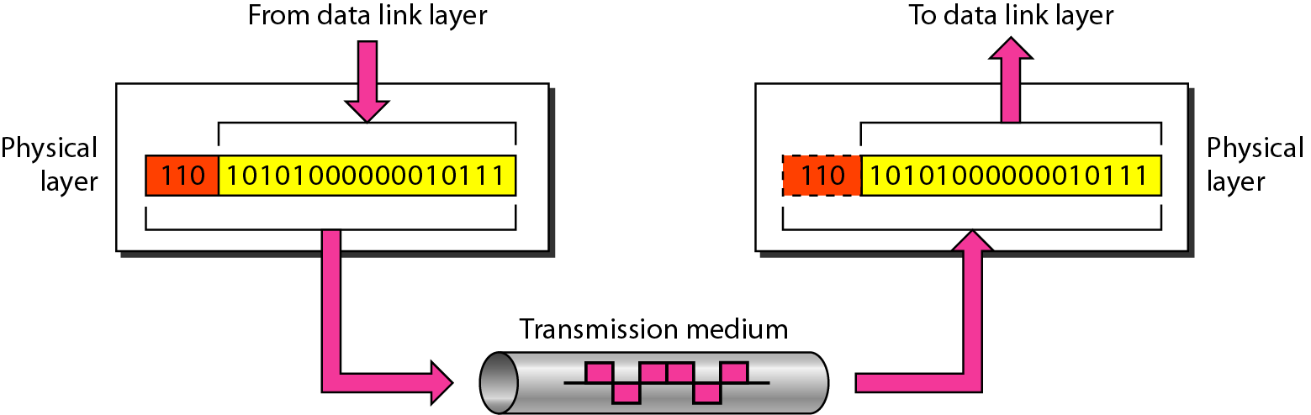
Physical Layer
The physical layer is responsible for movements of individual bits from one hop (node) to the next.

Slide 73
Physical Layer
Carries the bit stream over a physical media.
Physical Layer is concerned with:
Interface and Medium like guided cables
Representation of bits
Data rate
Synchronization of bits
Line configuration
Physical topology
Transmission mode

Slide 74
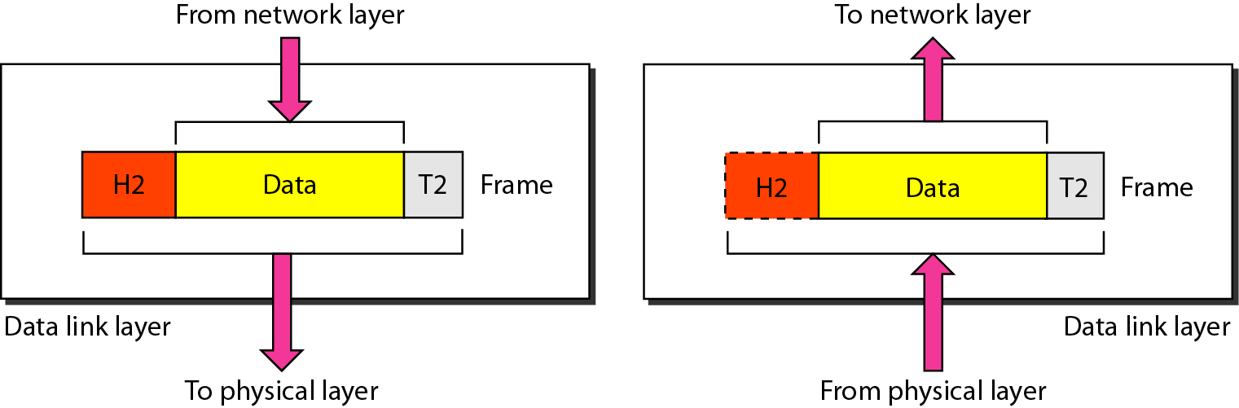
Data Link Layer
The data link layer is responsible for moving frames from one hop (node) to the next.

Slide 75
Data Link Layer
Data link layer is concerned with:
Framing – divide bits stream into data unit (frame)
Physical addressing
Flow control – avoid over overwhelming
Error control – bit loses, retransmission
Access control

Slide 76
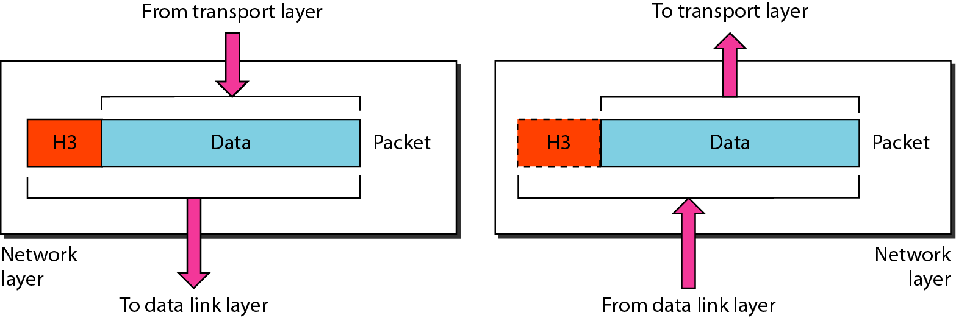
Network Layer
The network layer is responsible for the delivery of individual packets from the source host to the destination host.

Slide 77
Network Layer
In this layer, packet is combined with header and data.
In case of data link layer, packet delivers on the same network.
If two different networks are connected then packet is concern with network layer.
Network layer is concerned with:
Logical addressing e.g. 192.168.1.1 (IP Address)
Routing

Slide 78
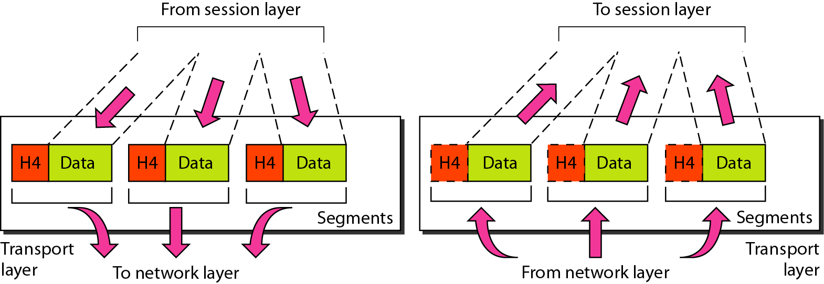
Transport Layer
The transport layer is responsible for the delivery of a message from one process to another.

Slide 79
Transport Layer
This layer ensures that the whole message arrives intact and in order.
Transport layer is concerned with:
Service-point addressing (port address)
Segmentation and Reassembly
Connection Control
Flow and Error Control

Slide 80
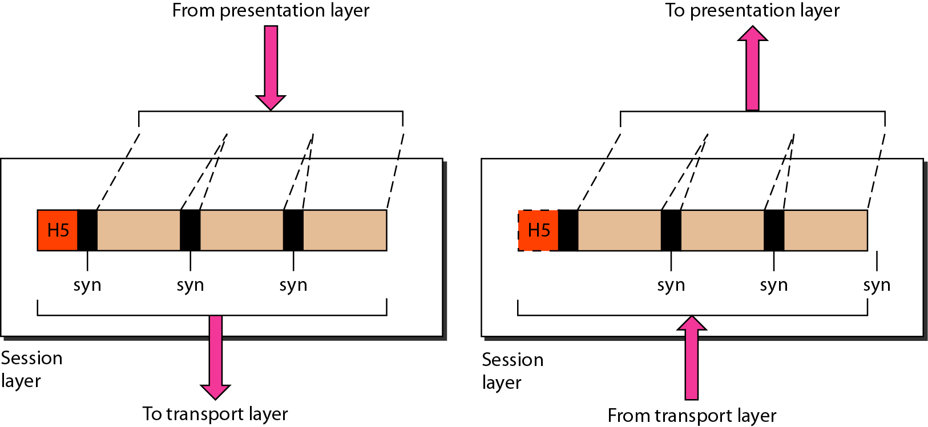
Session Layer
The session layer is responsible for dialog control and synchronization.

Slide 81
Session Layer
This layer is network dialog controller – establishes, maintains, synchronizes the interaction among computers.
Session layer is concerned with:
Dialog control
Synchronization

Slide 82
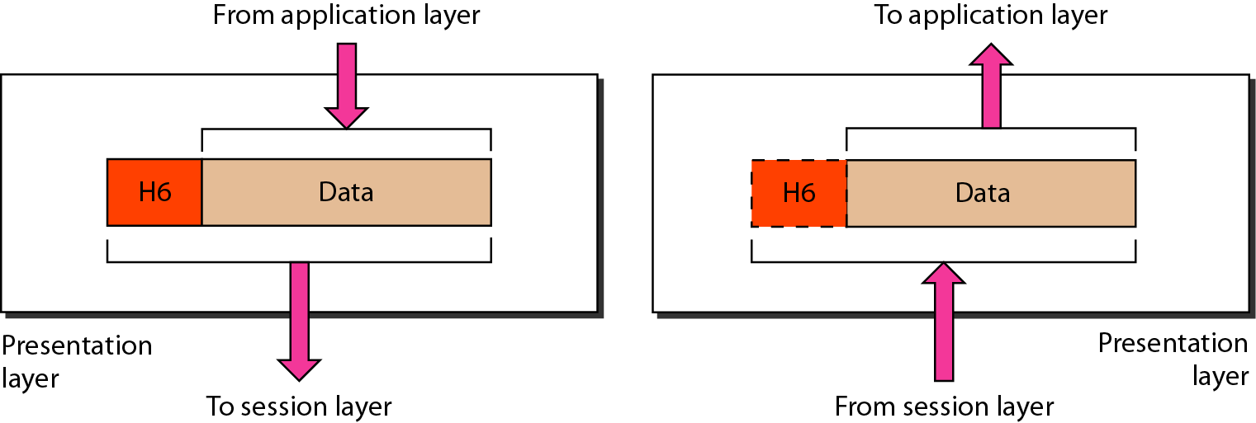
Presentation Layer
The presentation layer is responsible for translation, compression, and encryption.

Slide 83
Presentation Layer
This layer is concerned with the syntax which refers to order in which data is presented and semantics helps in interpreting a particular pattern.
Presentation layer is responsible for:
Translation
Encryption
Compression

Slide 84
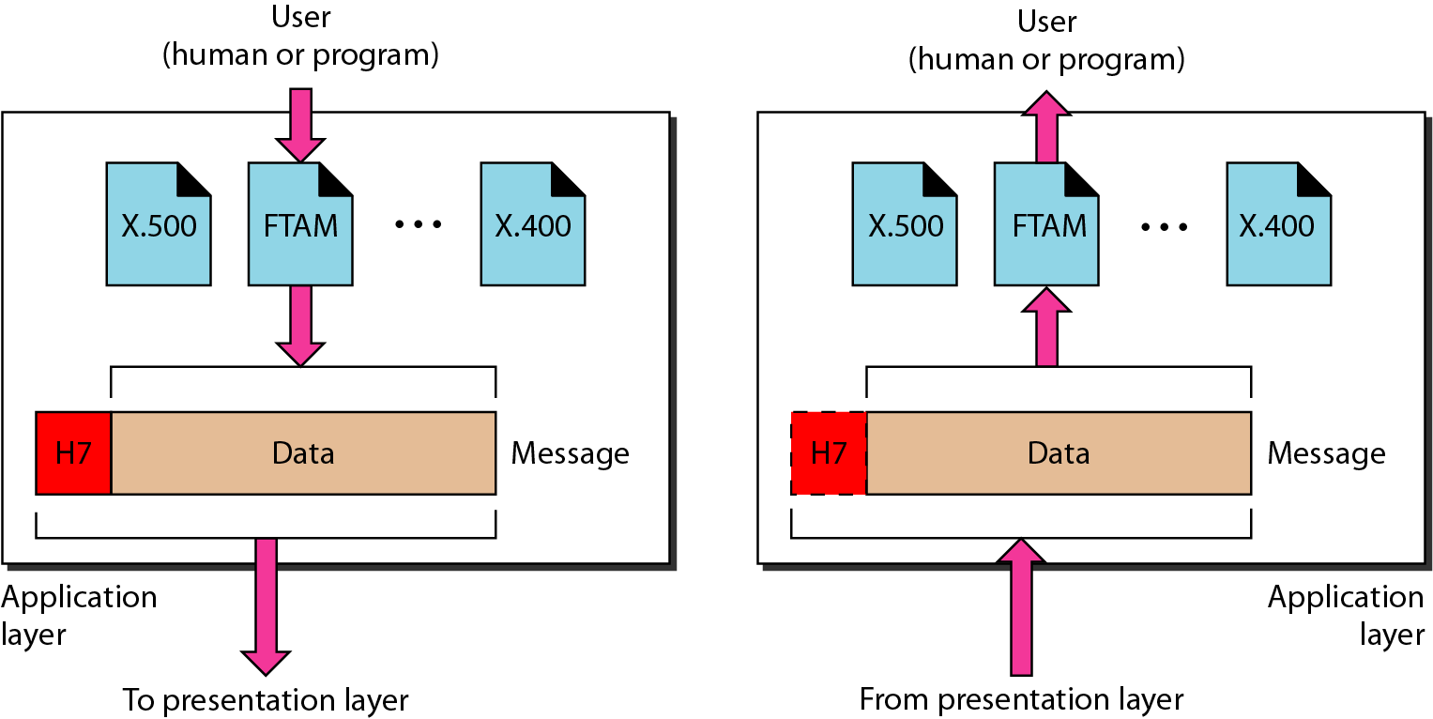
Application Layer
The application layer is responsible for providing services to the user.

Slide 85
Application Layer
This layer provides various services like:
Network virtual terminal
File transfer, access and management
Mail services
Directory services

Slide 86
Summary – OSI Layer
To allow access to network resource
Application
To translate, encrypt and compress data
Presentation
To establish, manage and terminate sessions
To provide reliable process-to-process message delivery and error recovery
Session
Transport
To move packets from source to destination; To provide internetworking
Network
To organize bits into frames; To provide hop-to-hop delivery
Data link
To transmit bits over a medium; To provide mechanical & electrical specification
Physical

Slide 87
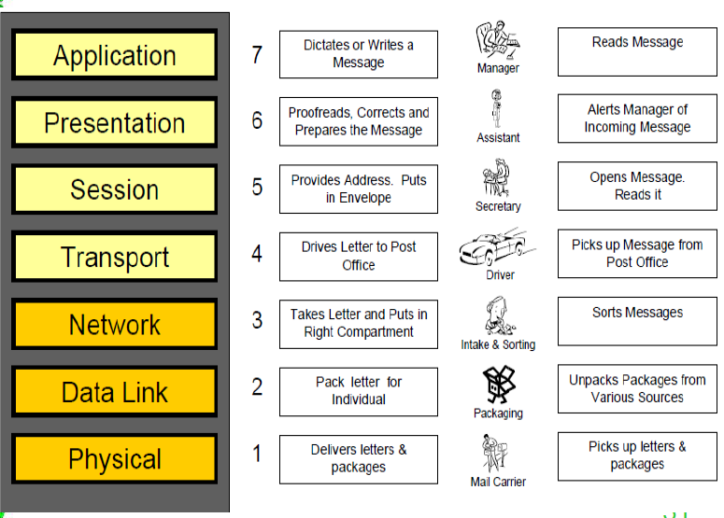
Example

Slide 88
TCP/IP Reference Model (Transmission Control Protocol/Internet Protocol)
It was originally defined as having five layers:
TCP/IP is a set of protocols developed to allow cooperating computers to share resources across the network.
Application Layer
Transport Layer
Network Layer
Data Link Layer
Physical Network

Slide 89
TCP/IP Reference Model
Like the OSI model, the TCP/IP model is layered and is used in the same fashion as the OSI model but with fewer layers.
As the modern Internet and most communications use the Internet Protocol (IP), the TCP/IP model is technically more in line with modern network implementations.
As stated before, the layers within the TCP/IP model are considered less rigid then that of the OSI model, which basically means that many protocols implemented can be considered in grey areas between one area and another.
The TCP/IP protocol suite (often referred to as the TCP/IP protocol) contains the same protocols referenced in the earlier OSI model sections.

Slide 90
TCP/IP Reference Model
What is TCP/IP?
TCP/IP is a set of protocols (Protocol Suit) that enable communication between computers.
Protocols are rules or standards that govern communications.
If two devices in a network need to communicate, they need to use a common protocol. E.g. human communication.

Slide 91
TCP/IP Reference Model
You can select from different network protocols to use in your network, but TCP/IP is the industry standard.
Almost all Operating Systems now support TCP/IP. Internet is working on TCP/IP.
TCP/IP is known as "the language of the Internet." If you want a computer to work on the Internet, you have to use TCP/IP.

Slide 92
TCP/IP Reference Model :History
The ARPANET, a research network group connected hundreds of universities and gown installations, using leased telephone lines.
The predecessor of today’s Internet was ARPAnet, created by the Advanced Research Projects Agency (ARPA) and launched in 1969 during "Cold War".
The protocol used on the ARPAnet was called Network Control Protocol (NCP).
As the ARPAnet grew, however, a new protocol was needed because NCP was not able
In 1974 Vint Cerf and Bob Kahn, published a paper “A Protocol for Packet Network Interconnection.” This paper describes the Transmission Control Protocol (TCP), which eventually replaced NCP. to fulfil all the needs of a larger network.

Slide 93
TCP/IP Reference Model
By 1978, testing and further development of this language led to a new suite of protocols called Transmission Control Protocol/Internet Protocol (TCP/IP).
5Layers
Distinction between these three concepts are explicit.
Protocols in TCP/IP model are not hidden and tough to replace if technology changes.
The model was not biased toward one particular set of protocols, a fact that made it quite general.

Slide 94
TCP/IP Reference Model
Designers have much experience with the subject and have clear idea of which functionality to put in which layer.
Network Layer, supports both, connection oriented and connectionless communication.
More precise.
Doesn’t give emphasis on clear interface between layers. Protocol works specially for transport and network layer.

Slide 95
The Physical Layer
Transmitting raw bits over a communication channel.
Works as Transporter, to carry bits from one end to another.
Converts the bits to voltage or light pulse and at the other end, converts incoming voltage or light pulse to bits.
Checks whether message has to be broadcasted or unicasted.

Slide 96
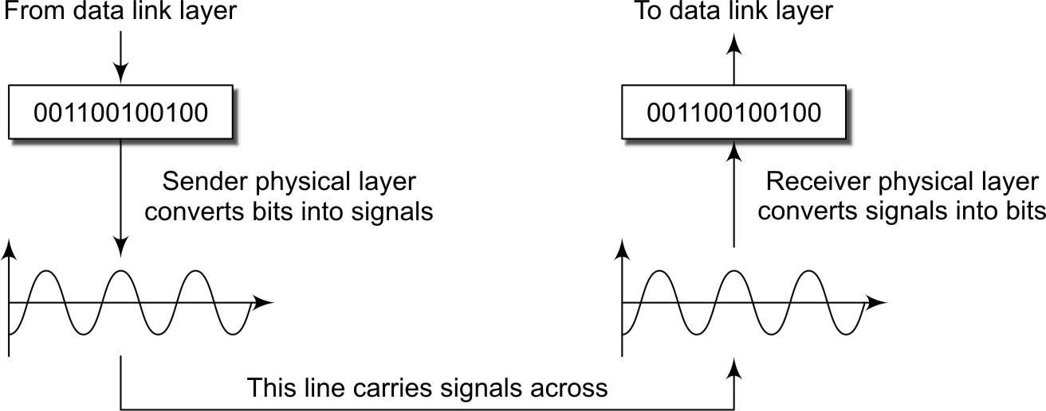
The Physical Layer

Slide 97
The Data Link Layer
Data link layer has to encapsulate the data into the body of unit called frame.
The No Monopoly idea and the framing
Framing Techniques
Error Control
Flow Control

Slide 98
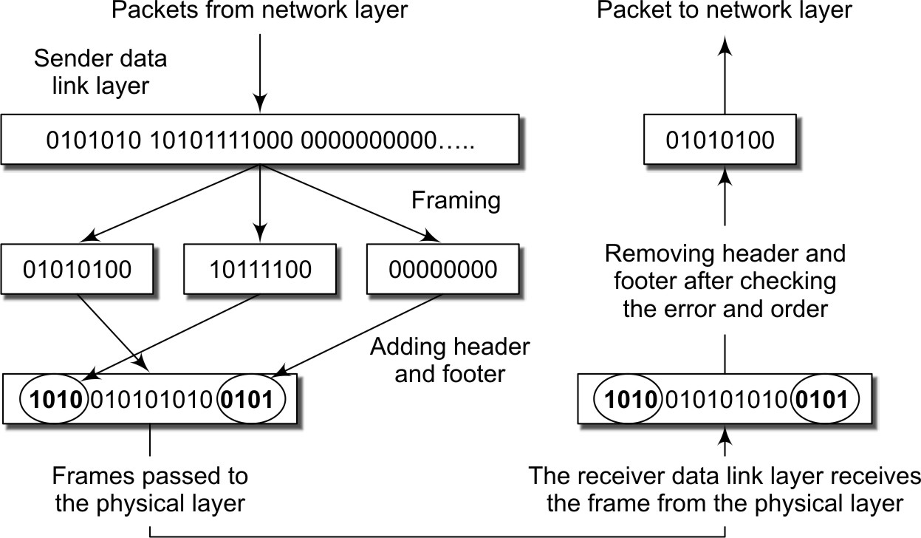
The Data Link Layer

Slide 99
The Network Layer
The network layer’s job is to look at the actual destination address and decide the intermediate router through which the packet can be delivered.
Handling accounting for usage of network resources
Devise and implement mechanisms of identifying each machine uniquely
Implement connectionless or connection-oriented forwarding
Multiplexing and de-multiplexing the transport layer and the data link layer jobs

Slide 100
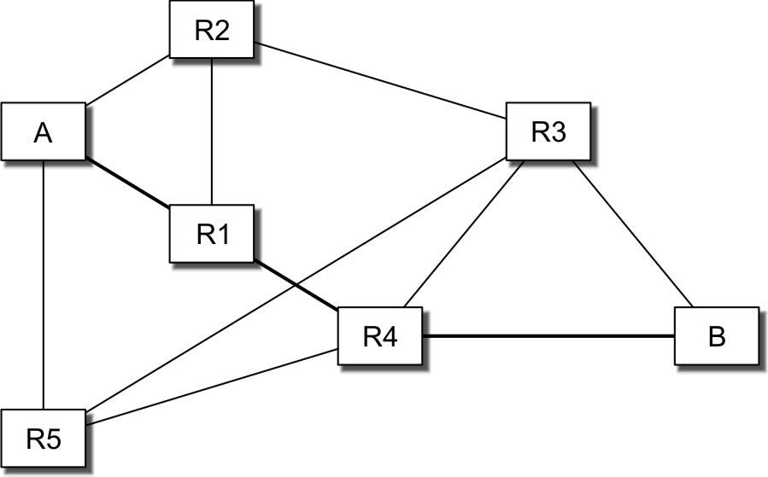
The Network Layer

Slide 101
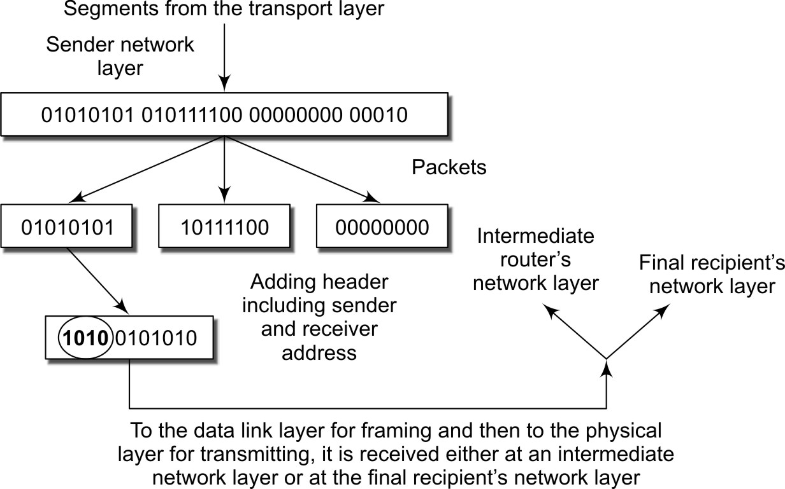
The Network Layer

Slide 102
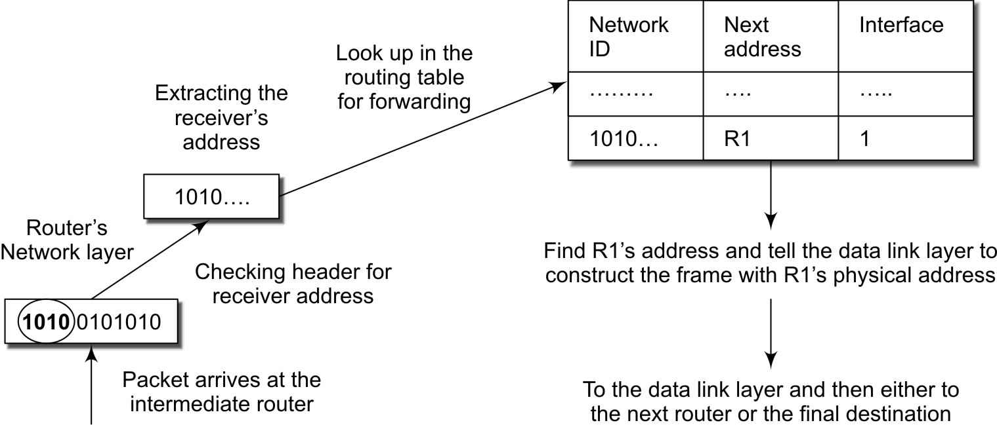
The Network Layer: Routing at Network Layer

Slide 103
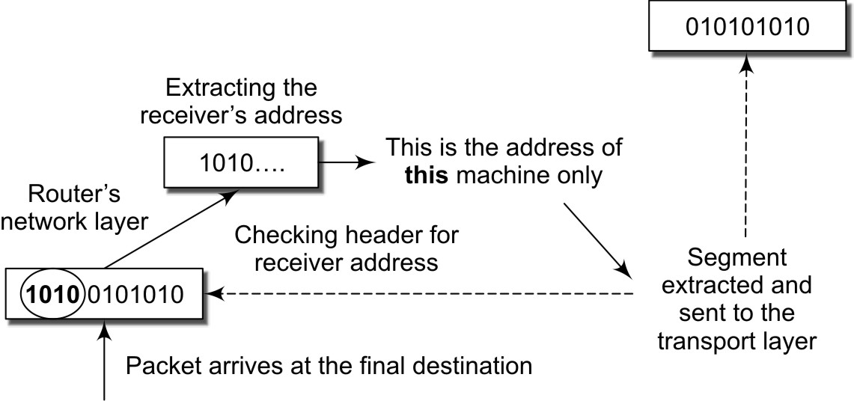
The Network Layer: Extracting Prefix

Slide 104
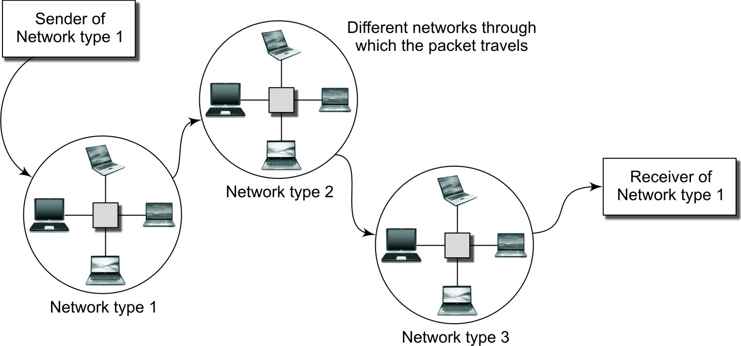
The Network Layer: Routing between different networks

Slide 105
The Transport Layer
This layer is the secretary of the application layer.
Retransmission
Adapted Retransmission Time according to Load
Ordered Delivery
Optimum Utilization of Bandwidth
Flow Control
Real Time Delivery
Quality of Delivery

Slide 106
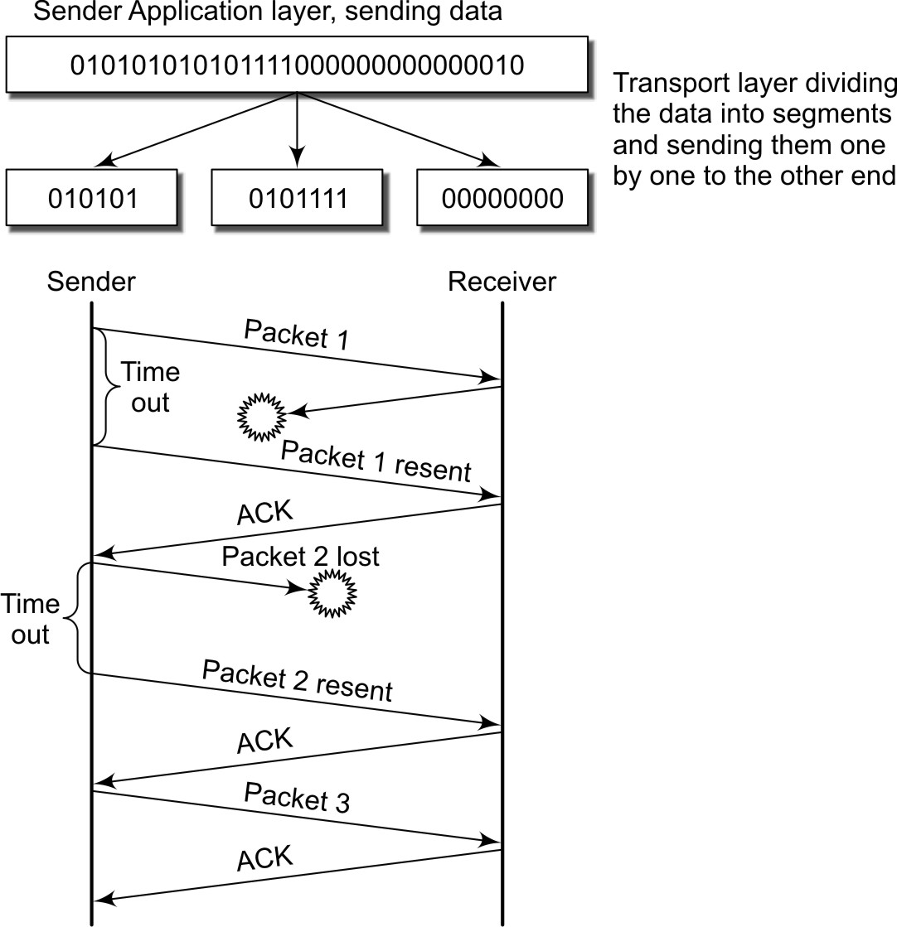
The Transport Layer

Slide 107
Application Layer
This layer work as direct communication for client or user.
Application layer contains a variety of protocols that are commonly needed by users.
Widely-used application protocol is HTTP (Hyper Text Transfer Protocol), which is the basis for the World Wide Web.
When a browser wants a Web page, it sends the name of the page it wants to the server using HTTP.
The server then sends the page back.
Other application protocols are used for file transfer, electronic mail, and network news.

Slide 108
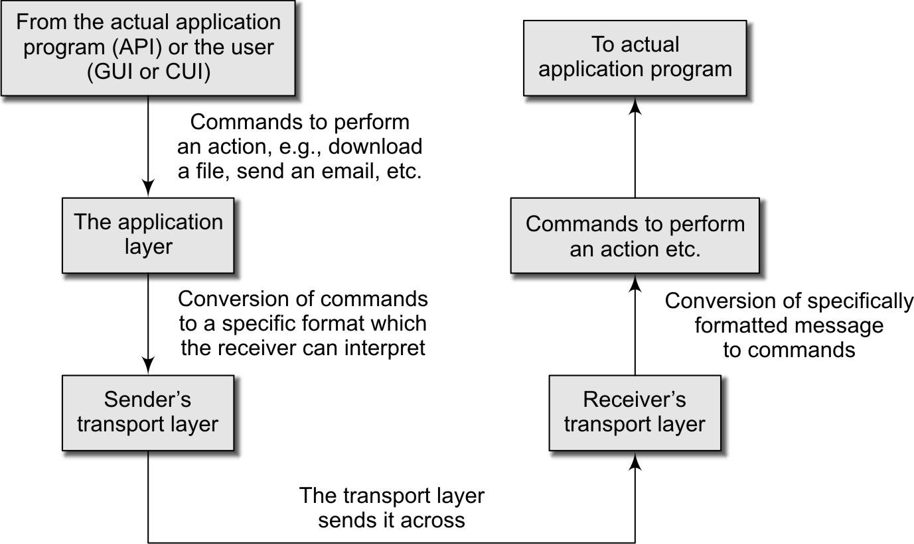
Application Layer

Slide 109
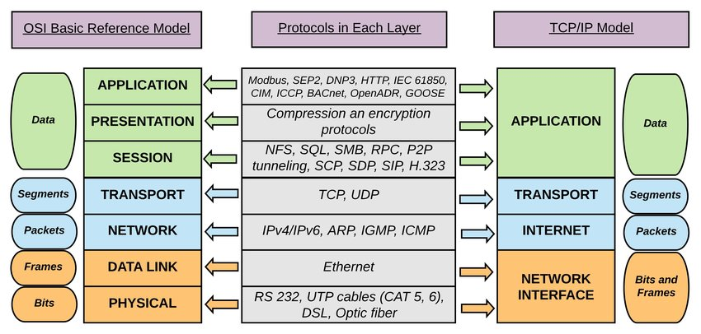
OSI and TCP/IP comparison

Slide 110
Difference - OSI Model and TCP/IP Protocol Layers
OSI Model
&
TCP/IP Protocol Layer
OSI (Open System Interconnection) | TCP/IP (Transmission Control Protocol/ Internet Protocol)
It has 7 layers | It has 5 layers
OSI provides layer functioning and also defines functions of all the layers | TCP/IP model is more based on protocols and protocols are not flexible with other layers
Follows horizontal approach | Follows vertical approach
OSI model has a separate presentation layer | TCP/IP doesn’t have a separate presentation layer
OSI model has a problem of fitting the protocols in the model | TCP/IP model does not fit any protocol

Slide 111
Difference - OSI Model and TCP/IP Protocol Layers
OSI (Open System Interconnection) | TCP/IP (Transmission Control Protocol/ Internet Protocol)
OSI Model
&
TCP/IP Protocol Layer
Network layer of OSI model provide both connection oriented and connectionless service | The Network layer in TCP/IP model provides connectionless service
OSI provides layer functioning and also defines functions of all the layers | TCP/IP model is more based on protocols and protocols are not flexible with other layers
Protocols are hidden in OSI model and are easily replaced as the technology changes | In TCP/IP, replacing protocol is not easy
OSI model defines services, interfaces and protocols very clearly and makes clear distinction between them | In TCP/IP, it is not clearly separated its services, interfaces and protocols
In OSI model the transport layer guarantees the delivery of packets | In TCP/IP model the transport layer does not guarantees delivery of packets

Slide 112
Comparison
Basis of Comparison | Connection-oriented service | Connection-less service
Prior Connection Requirement | Necessary | Not required
Reliability | Ensures reliable transfer of data. | Not guaranteed.
Congestion | Unlikely | Occur likely.
Transferring mode | It can be implemented using circuit switching and virtual circuit. | It is implemented using packet switching.
Lost data retransmission | Feasible | Practically, not possible.
Suitability | Suitable for long and steady communication. | Suitable for bursty Transmission.
Signalling | Used for connection establishment. | There is no concept of signalling.

Slide 113
Comparison
Basis of Comparison | Connection-oriented service | Connection-less service
Packet forwarding | Packets sequentially travel to their destination node and follows the same route. | Packets reach the destination randomly without following the same route.
Delay | There is a delay in transfer of information, but once the connection is established faster delivery can be achieved. | Because to the absence of connection establishment phase, the transmission is faster.
Resource Allocation | Need to be allocated. | No prior allocation of the resource is required.

Slide 114
DNS – Basic Terminology
DNS:-
The domain name system, more commonly known as "DNS" is the networking system in place that allows us to resolve human-friendly names to unique addresses.
Domain Name:
A domain name is the human-friendly name that we are used to associating with an internet resource. For instance, "google.com" is a domain name.
IP address:
An IP address is what we call a network addressable location. Each IP address must be unique within its network. For example, "111.222.111.222" could be a valid IPv4 IP address.

Slide 115
The Domain Name System (DNS)
DNS technology allows hosts on TCP/IP networks (such as Internet Web
sites) to be addressed by names.
DNS automatically converts the names we type in our web browser address
bar to the IP addresses of web servers hosting those sites.
Each Internet address is mapped to a symbolic name, using the DNS, in the
format of:
<computer-name>.<sub domain hierarchy>.<organization>.<sector name> {.<country code>}
e.g., www.csc.calpoly.edu.us

Slide 116
The Domain Name System (DNS)

Slide 117
The Domain Name System (DNS)
E.g. acme.com – the last component i.e. .com is top level domain.
Acme – is the second level domain.
Sub domain e.g. – marketing.acme.com
Domain names are not case sensitive.
For network applications, a domain name must be mapped to its corresponding Internet address.
The mapping service is offered by thousands of DNS servers on the Internet, each responsible for a portion of the name space, called a zone.

Slide 118
Domain name hierarchy

Slide 119
Email Address & URL’s
Email address: username@domainName
For example: hemen@silvertouch.com
URLs: Stands for Uniform Resource Locator
Form of URL:
<protocol>//<user>:<password>@<host-id>:<port-number>/<directory path>
Where
<protocol>: It is the name of the application layer protocol you wish to use to access the resource.
<user>:<password>: is for access authorization, if required by the protocol.
<host-id>: It is the domain name or dotted-decimal IP address of the host.
<port-number> : is transport layer protocol port for the process that provides the service on the remote host.
<directory path>:
Specifies where in the file system of the remote host the resource can be located.

Slide 120
Roadmap
1.1 Definition
1.2 History of DC
1.3 Different forms of Computing
1.4 Strength & Weakness
1.5 Basics of OS
1.6 Network Basics
→ 1.7 Software Engineering Basics
1.8 The Architecture of Distributed Application.

Slide 121
1.7 S.E. Basics
Procedural vs Object Oriented Programming
In procedural programing our code is organised into small "procedures" that use and change our data.
we write our procedures as either custom tags or functions. These functions typically take some input, do something, then produce some output.
E.g. C language.
In object oriented programming, the data and related functions are
bundled together into an "object".
Ideally, the data inside an object can only be manipulated by calling the
object's functions.
E.g. JAVA

Slide 122
Unified Modeling Language
The Unified Modeling Language (UML) is a general-purpose modeling language in the field of software engineering, which is designed to provide a standard way to visualize the design of a system

Slide 123
Roadmap
1.1 Definition
1.2 History of DC
1.3 Different forms of Computing
1.4 Strength & Weakness
1.5 Basics of OS
1.6 Network Basics
1.7 Software Engineering Basics
→ 1.8 The Architecture of Distributed Application.

Slide 124
1.8 Architecture of Distributed Application
The idea of using a multilayer architecture to organize the functionalities of data network can applied to distributed applications.
Presentation
Application (Business) Logic
Services
The architecture of distributed applications

Slide 125
1.8 Architecture of Distributed Application
Presentation Layer: This layer provides the user interface. For example, if the application is a shopping cart, this layer generates the set of web pages that are viewable by a shopper using a browser.
Application Layer: This layer provides the computation for the application. This layer is also called the business logic layer for enterprise applications. In a shopping cart application, this layer is responsible for such tasks as credit verification and computing the dollar amounts of the orders, sales tax, and delivery cost.
Service Layer: This layer provides the underlying services needed to support the functionalities of the top layers. Services may include data access facilities, directory services for name lookups, and inter process communication.

Slide 126
Roadmap part-2
Paradigms and Abstraction
Paradigms for Distributed Applications

Slide 127
Introduction
A paradigm is a standard, perspective, or set of ideas. A paradigm is a way of looking at something.
A paradigm is a new way of looking or thinking about something.
Distributed Computing is one of the most vibrant area in computer science.
There is an ongoing evolution of new technologies for supporting network applications, bringing with them new conceptual models and terminologies.

Slide 128
Paradigms & Abstraction
Abstraction:
Arguably the most fundamental concept in computer science, abstraction is the idea of encapsulation, or detail hiding.
In software engineering, abstraction is realized with the provision of tools or facilities that allow software to be built without the developer having to be cognizant (having knowledge) of some of the underlying complexities.
It is not an overstatement to say that the tools for abstraction are the force behind modern-day software, and they exist in every aspect of application development.

Slide 129
As examples, we make use of compilers to abstract the detail of the machine languages.
In the area of distributed applications, there has been an explosion of tools and facilities based on a wide variety of paradigms that offer varying degrees of abstraction.

Slide 130
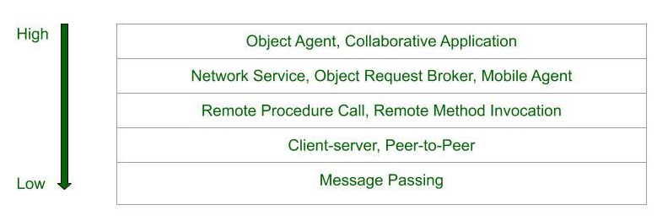
Paradigms:
Paradigm means an idea or pattern.
Distributed computing paradigms and their level of abstraction.

Slide 131
Roadmap
Paradigms and Abstraction
Paradigms for Distributed Applications

Slide 132
Distributed Computing Paradigms
Paradigm means “a pattern, example, or model.” In the study of any subject of great complexity, it is useful to identify the basic patterns or models, and classify the detail according to these models.
The paradigms will be presented in the order of their level of abstraction as shown in fig 3.1. At the lowest level of abstraction is Message passing which encapsulates the least amount of detail and the Object Space occupies the highest level of abstraction among all the paradigms.

Slide 133
Paradigms for Distributed Applications
There are various paradigms of distributed applications.
Message Passing
The Client Server Paradigm
The Peer-to-Peer Paradigm
The Message System Paradigm
Remote Procedure Call Model
The Distributed Object Paradigms
The Object Request Broker Paradigm
The Mobile Agent Paradigm
The Network Service Paradigm
The Collaborative Application (Groupware) Paradigm

Slide 134
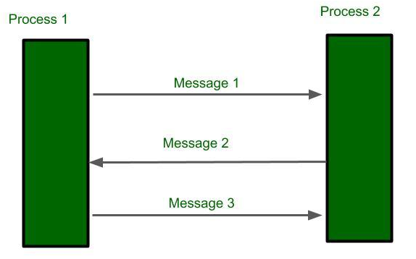
1 - Message Passing
Message passing is the most fundamental paradigm for distributed applications.
• A process sends a message representing a request.
• The message is delivered to a receiver, which processes the request, and sends a message in response.
Operations: send, receive
Connections: connect, disconnect

Slide 135
1 - Message Passing
With the abstraction provided by this model, the interconnected processes perform input and output to each other, in a manner similar to file I/O.
The I/O operations encapsulate the detail of network communication at the operating-system level.
The socket application programming interface is based on this paradigm

Slide 136
2 - The Client Server Paradigm
Distributed computing paradigms and their level of abstraction.

Slide 137
2 - The Client Server Paradigm
The best known paradigm for network applications, the client-server model assigns asymmetric roles to two collaborating processes.
One process, the server, plays the role of a service provider which waits passively for the arrival of requests. The other, the client, issues specific requests to the server and awaits its response.
Simple in concept, the client-server model provides an efficient abstraction for the delivery of network services. Operations required include those for a server process to listen and to accept requests, and for a client process to issue requests and accept responses.
Many Internet services are client-server applications. These services are often known by the protocol that the application implements. Well known Internet services include HTTP, FTP, DNS, finger, gopher, etc.
Server Process: listen, accept
Client Process: issue the request, accept the response

Slide 138
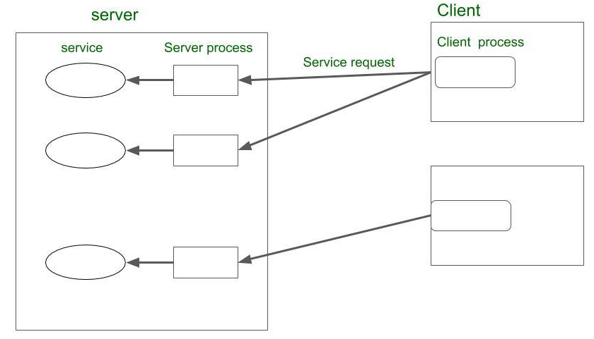
2 - The Client Server Paradigm

Slide 139
3 - The Peer-to-Peer Paradigm

Slide 140
3 - The Peer-to-Peer Paradigm
In system architecture and networks, peer-to-peer is an architecture where computer resources and services are direct exchanged between computer systems.
These resources and services include the exchange of information, processing cycles, cache storage, and disk storage for files.
In such architecture, computers that have traditionally been used solely as clients communicate directly among themselves and can act as both clients and servers, assuming whatever roles are most efficient for the network.
In the peer-to-peer paradigm, the participating processes play equal roles, with equivalent capabilities and responsibilities (hence the term “peer”).
Each participant may issue a request to another participant and receive a response.

Slide 141
3 - The Peer-to-Peer Paradigm
Where the client-server paradigm is an ideal model for centralized network service, the peer-to-peer paradigm is more appropriate for applications such as instant messaging, peer-to-peer file transfers, video conferencing, and collaborative work.
It is also possible for an application to be based on both the client-server model and the peer-to-peer model.
Example: A well-known example of a peer-to-peer file transfer.

Slide 142
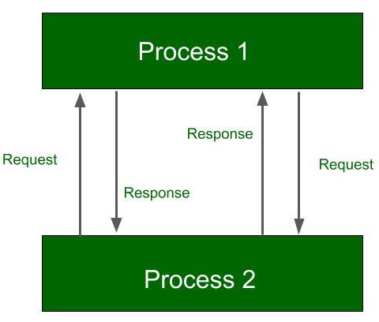
3 - The Peer-to-Peer Paradigm

Slide 143
4. Message System Paradigm

Slide 144
4 - Message System Paradigm
Message system act as intermediate among independent processes.
It is also act as switch through which process exchange messages asynchronously in decoupled manner.
sender sends message which drop at first in message system then forward to message queue which is associated with the receiver

Slide 145
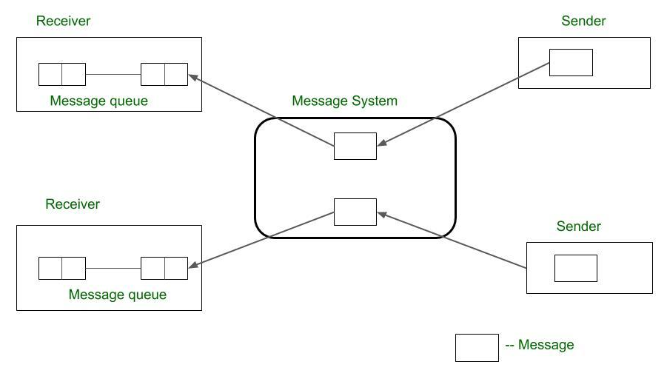
4 - Message System Paradigm

Slide 146
4 - Message System Paradigm
There are two main subtypes of message system models
1) The Point-To-Point Message Model
2) The Publish/Subscribe Message Model
Point to Point message model:
Forward message from sender to receiver via message system.
The message system keeps repository of messages and directly forward messages to the receiver’s message queue.
Unlike the basic message-passing model, it provides asynchronous message passing.

Slide 147
4 - Message System Paradigm
2) Public/Subscribe Model:
In this model, each message is associated with a specific topic or event. whoever interest in the messages can subscribe to the event before it occurs.
When the waited event occurs, the process publishes the message with an event or topic. Then the message system distributes messages to all the subscribers. Example: IBM MQ service, Microsoft Message Queuing

Slide 148
5 - Remote Procedure Call Model

Slide 149
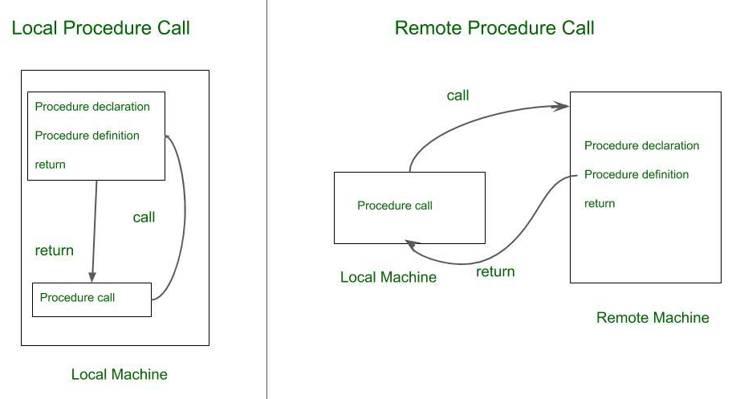
5 - Remote Procedure Call Model
Local procedure call happens only within a local machine.
Remote Procedure call(RPC) happens between two remote machines.

Slide 150
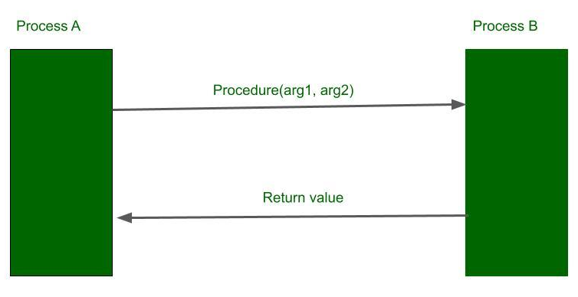
5 - Remote Procedure Call Model

Slide 151
5 - Remote Procedure Call Model
RPC involves two independent processes that may reside on a separate machine.
Process A wishing to make a request process B for procedure call with a list of arguments.
Process B operates the procedure and return values to Process A.

Slide 152
The Distributed Object Paradigm

Slide 153
The Distributed Object Paradigm
Application access the objects distributed over the network.
Objects provide methods, through the invocation of which an application obtains access to services.
Object-oriented paradigms include:
Remote method invocation (RMI)
Network services
Object request broker (ORB)
Object spaces

Slide 154
6 - Remote Method Invocation
RMI is more like RPC but major difference is, it is object-oriented approach.
A process invokes the methods in an object, which may reside in a remote host.
Arguments may be passed with the invocation.

Slide 155
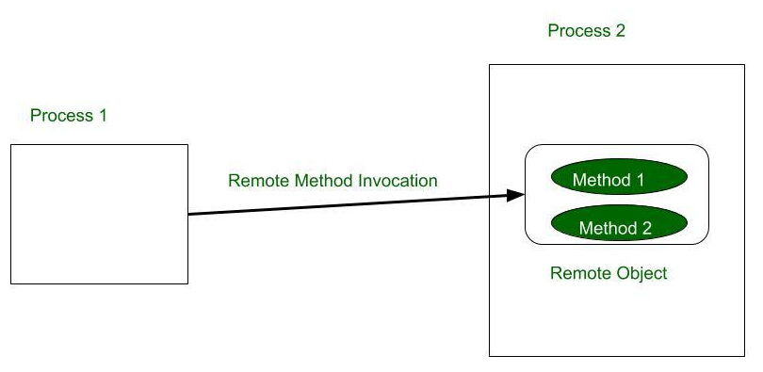
6 - Remote Method Invocation

Slide 156
7 - The Object Request Broker Paradigm

Slide 157
7 - The Object Request Broker Paradigm
In the object broker paradigm, a program issues requests to an object request broker (ORB), which directs the request to an appropriate object that provides the desired service.
The paradigm closely resembles the Remote Method Invocation model in its support for remote object access.
The difference is that the object request broker in this paradigm functions as middleware allowing an applications, as an object requester to potentially access multiple remote objects.

Slide 158
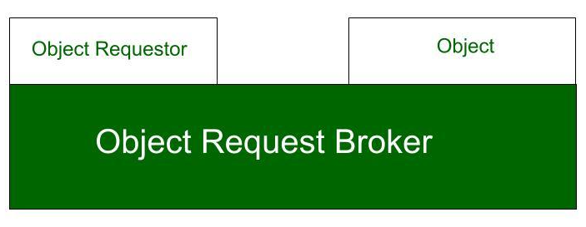
7 - The Object Request Broker Paradigm

Slide 159
8 - The Mobile Agent Paradigm

Slide 160
8 - The Mobile Agent Paradigm
A mobile agent is a transportable program or object.
In this paradigm, an agent is launched from an originating host.
The agent then travel autonomously from host to host accordingly to itinerary that it carries.
At each stop, the agent accesses the necessary resources or services and performs the necessary tasks to accomplish it mission.
The paradigm offers the abstraction for a transportable program or object.

Slide 161
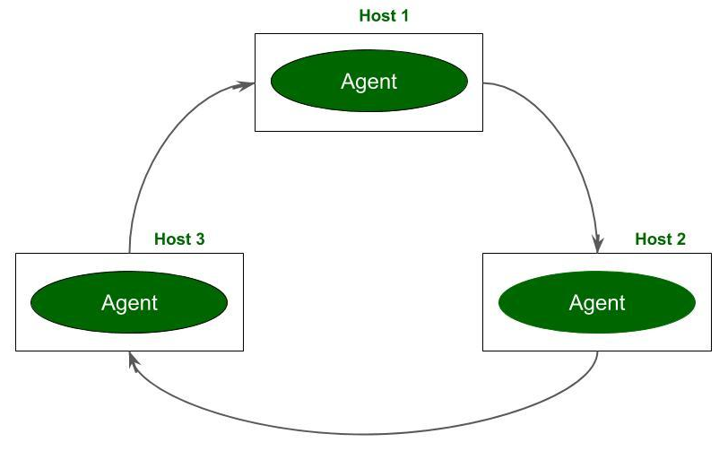
8 - The Mobile Agent Paradigm

Slide 162
9 - The Network Service Paradigm

Slide 163
9 - The Network Service Paradigm
In this paradigm service providers register themselves with directory servers on a network.
A process desiring a particular service contacts the directory server at run time, and, if the service is available, the process will be provided a reference to the service.
Using the reference, the process interacts with the service.
This paradigm is essentially an extension of the Remote Method Invocation paradigm.
The difference is that service objects are registered with a global directory service, allowing them to be looked up and accessed by service requesters on a federated network.

Slide 164
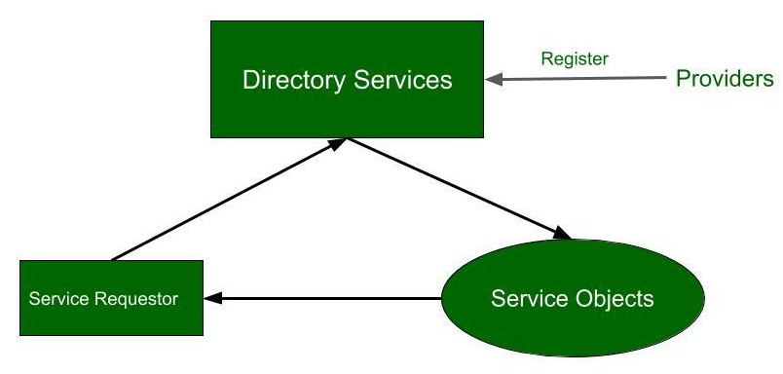
9 - The Network Service Paradigm
A federation is a group of computing or network providers agreeing upon standards of operation in a collective fashion.
The term may be used when describing the inter-operation of two distinct, formally disconnected, telecommunications networks that may have different internal structures

Slide 165
9 - The Network Service Paradigm
Ideally, services may be registered and located using a globally unique identifier, in which case, the paradigm offers an extra abstraction: location transparency.
Location transparency allows a software development to access an object or a service without having to be cognizant (aware) of the location of the object or service.

Slide 166
10 - The Collaborative Application(Groupware) Paradigm

Slide 167
10 - The Collaborative Application(Groupware) Paradigm
processes participate in a collaborative session as a group.
Each participating process may contribute input to part or all of the group.
Types:
Message based groupware paradigm
Whiteboard based groupware paradigm
Message based groupware paradigm: A host can multicast to send data to all hosts in the group or part of the hosts in the group. Whiteboard based groupware paradigm: The information is available on the public board in the group whoever in the group can access it.
Anyone can read or write data to a shared display

Slide 168
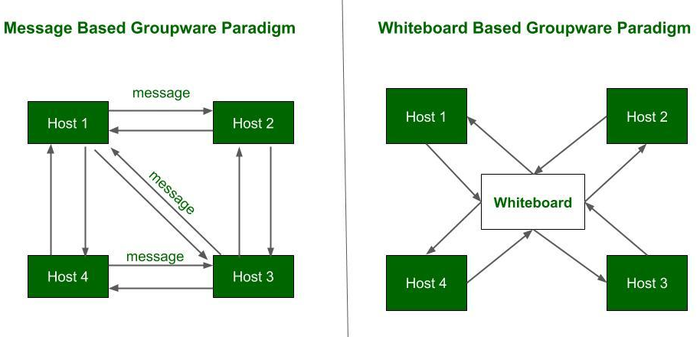
10 - The Collaborative Application(Groupware) Paradigm

Slide 169
11 - The Object Space
The object space paradigm assumes the existence of logical entities known as object spaces.
The participants of an application converge in a common object space.
A provider places objects as entries into an object space, and requestors who subscribe to the space may access the entries.
The object space paradigm provides a virtual space or meeting room among providers and requestors of network resources as objects.
Mutual exclusion is inherit in the paradigm, as an object in a space can be retrieved by only one participant at a time.

Slide 170
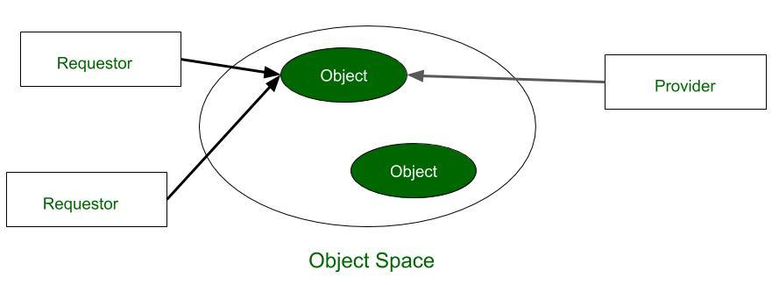
11 - The Object Space

Slide 171
QUESTIONS FOR PARADIGMS (DIFFERENCE)
1. Apply: In an online shopping application, compare the Client–Server Paradigm and Peer-to-Peer Paradigm for sharing product information among users. Which paradigm would be more suitable and why?
2. Analyse: Analyse the differences between the Remote Procedure Call (RPC) Model and the Message Passing Paradigm with respect to communication method, transparency, and system complexity.
3. Evaluate: Evaluate the suitability of the Distributed Object Paradigm and the Object Request Broker (ORB) Paradigm for developing a large-scale enterprise application. Justify your choice.
4. Apply: A university wants to develop a collaborative online platform for students to share documents, communicate, and work on group projects. Compare the Collaborative Application (Groupware) Paradigm and the Network Service Paradigm and recommend the most appropriate paradigm.
5. Analyse and Evaluate: Compare the Mobile Agent Paradigm and the Message System Paradigm in terms of mobility, communication overhead, fault tolerance, and security. Evaluate which paradigm is more appropriate for a distributed network monitoring application.

